Slide 1
SEM Analyses of the Links between 1st-Year Maternal Employment and Child Development
LASC Brown Bag Dec 3rd

Slide 2
Introduction
Why Maternal Employment and not paternal or both?
Very few changes in paternal employment over time
Not very many stay-at-home dads to compare against
Role of parents in household
Attachment Theory
School Readiness
Time with Children
Notes:
no significant main effects of early child care on attachment security or avoidance at 15 or 36 months
No links between working and parenting style

Slide 3
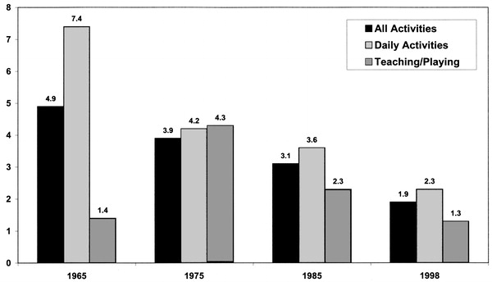
Ratio of married mothers' to married fathers' primary child care time

Slide 4
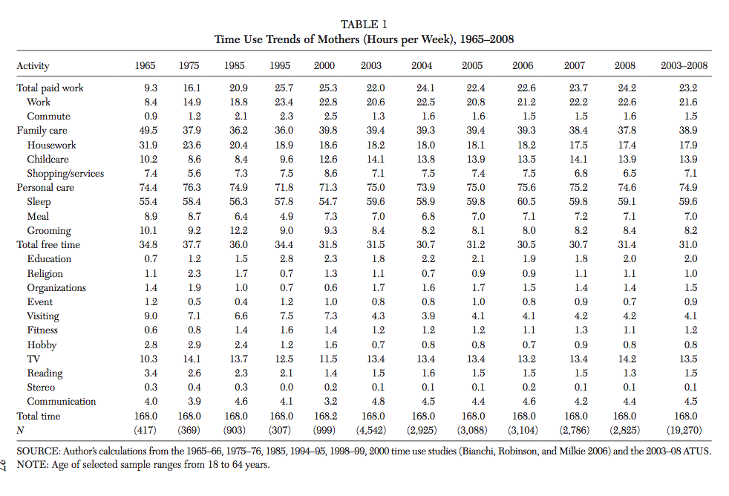

Slide 5
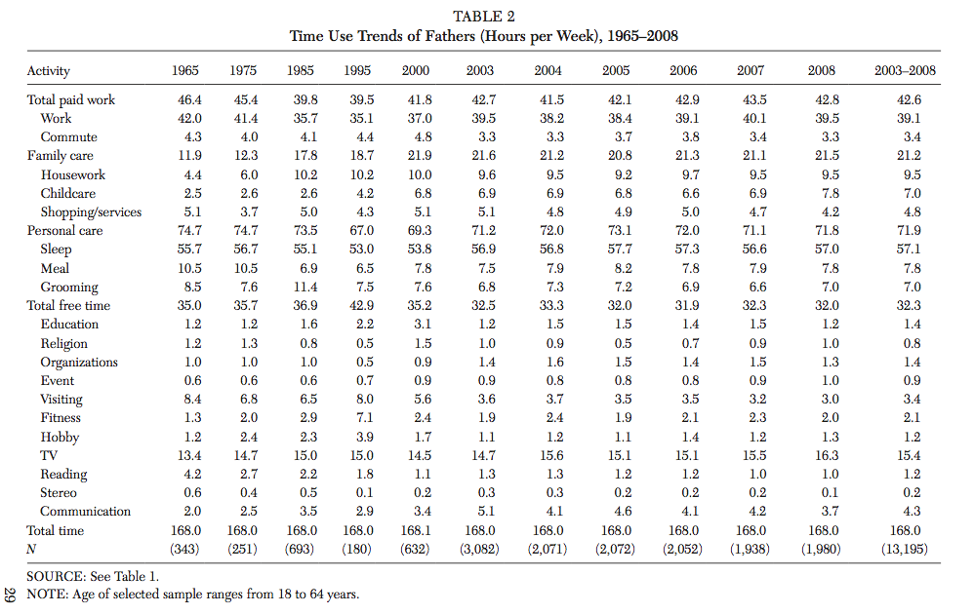

Slide 6
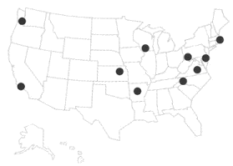
Current Study
NICHD (National Institute of Child Health and Development) Study of Early Child Care
1,364 children born in 1991; 1,040 at end of study (76%)
Follow up home and child care visits at 1, 6, 15, 24, 36, 54 months and first grade
Phone interviews every 3 months until kindergarten entry
Notes:
Families who were living in difficult
circumstances (e.g., mothers under 18, families who anticipated
moving, infants who were multiple births or had health problems or disabilities,
mothers who did not speak English, mothers with medical
problems or substance abuse problems, or families living in a dangerous
neighborhood) were excluded from the study

Slide 7
Measures
Bracken School Readiness Scale (36 months)
51 items that asses children’s knowledge of color, letter identification, number identification, counting, comparisons, and shape recognition.
Measured on percentile rank (M = 45.19, SD = 26)
Woodcock Johnson Achievement and Cognitive Batteries (4.5, first grade)
Language Skills Composite: auditory processing, picture vocabulary test, letter-words identification test
Applied Problems Test: analyzing and solving basic math problems
Preschool Language Scale (4.5)
Auditory comprehension and Expressive communication

Slide 8
Measures
Child Behavior Checklist (36 months; 54 months)
Checklist of child behaviors ranging from 0 (not true of the child) to 2 (very true of the child)
Used to measure externalizing behaviors
Measured by both the parents and the child care provider or teacher
Externalizing behavior
Unwanted actions taken on the outside world; commonly called “behavior problems”
Examples: disobeying rules, aggression, vandalism, threatening others, fighting, disrupting class

Slide 9
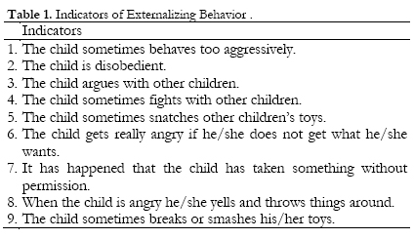
Measures

Slide 10
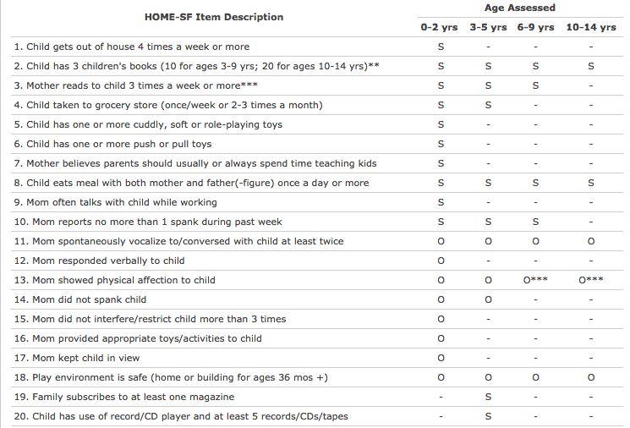
Measures
Home Observation for Measurement of the Environment

Slide 11
Measures
Maternal Employment
Categorized
Not employed
Part time work: employed less than 30 hours a week
Full time work: employed more than 30 hours a week
Type of job

Slide 12
Results
Preliminary results indicate no differences between working mothers and non-working mothers, but strong differences between part-time work and full time work
Negative effect of full time work vs. part time work
Many of the mediating variables are intercorrelated (maternal earnings with HOME score, for example)

Slide 13
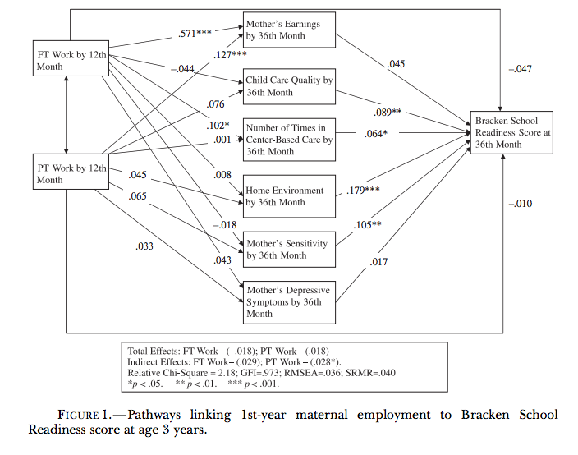
Notes:
FT Work +> Number of times in Child care +> Bracken
Other effects are not consistently significant

Slide 14
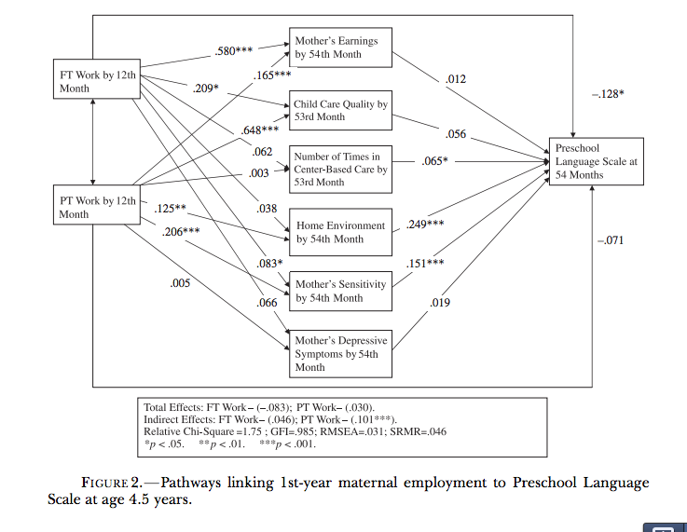
Notes:
FT +> Sensitivity +> PLS

Slide 15
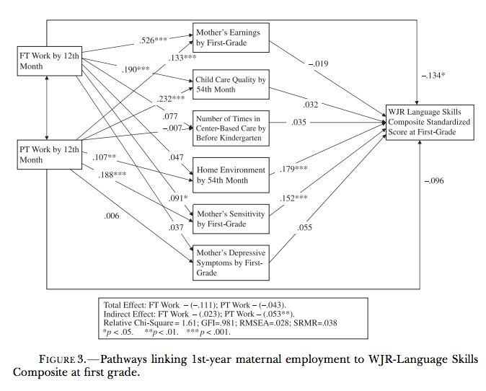
Notes:
FT +> Sensitivity +> Language

Slide 16
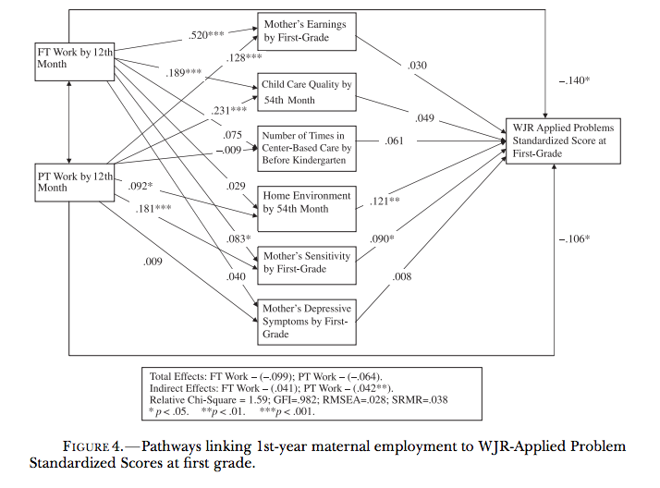

Slide 17
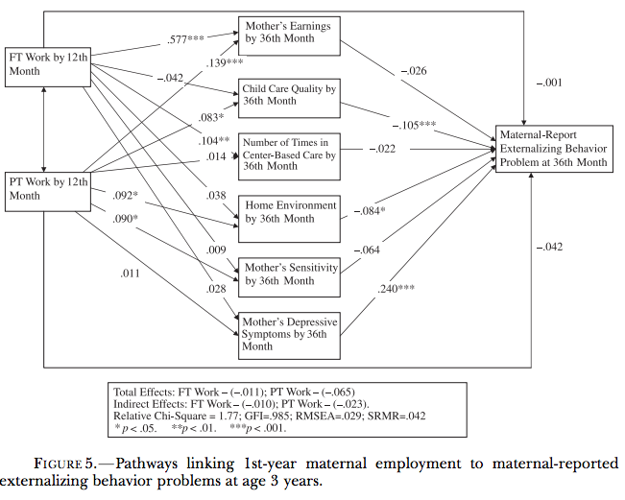

Slide 18
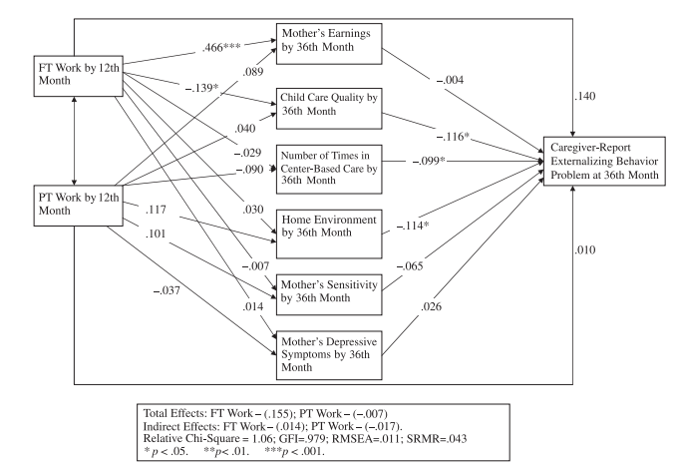

Slide 19
Discussion
“The results show conclusively that the overall effect of 1st-year maternal employment for contemporary American children is neutral.”
Parenting styles and quality of child care vastly more important
Notes:
FT employment in the 1st year does have significant and negative
overall direct effects on later child cognitive outcomes, compared with not
working in the 1st year, as was seen in the OLS models (and in prior research),
but those effects are counterbalanced by positive overall indirect
effects, and thus the total effect of FT employment in the 1st year, on average,
is neutral.
Some potential positive effects of PT work

Slide 20
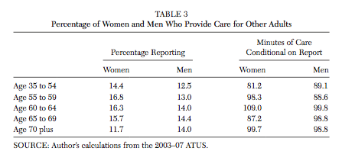
Discussion

